Slide 1
Physics in Circuits and Gadgets (part 2)

Slide 2
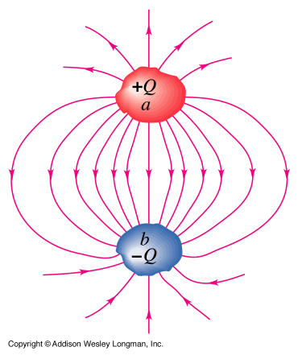
Capacitor
A device that stores charges
Compose of two conductors insulated from one another
Insulator between the two conductors: vacuum or dielectric

Slide 3
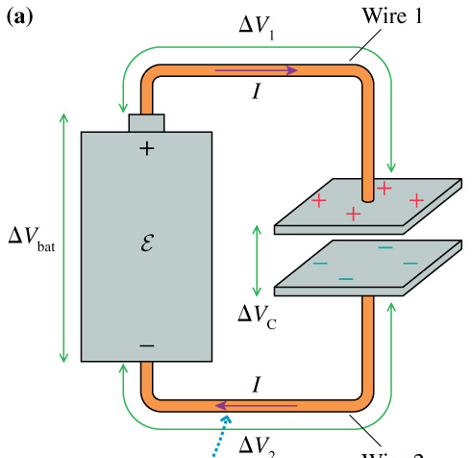
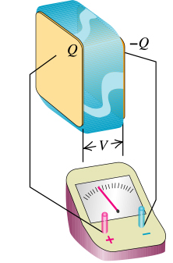
Capacitor
Input: Voltage
Output: Store charges

Slide 4
Capacitance (C)
ability of a body to store electrical charge (Q)
Unit: Farad
Store charges
Input Voltage
(c) Addison Wesley Longman, Inc

Slide 5
Capacitance (C)
If input V changes → store Q would change (C is constant)

Slide 6
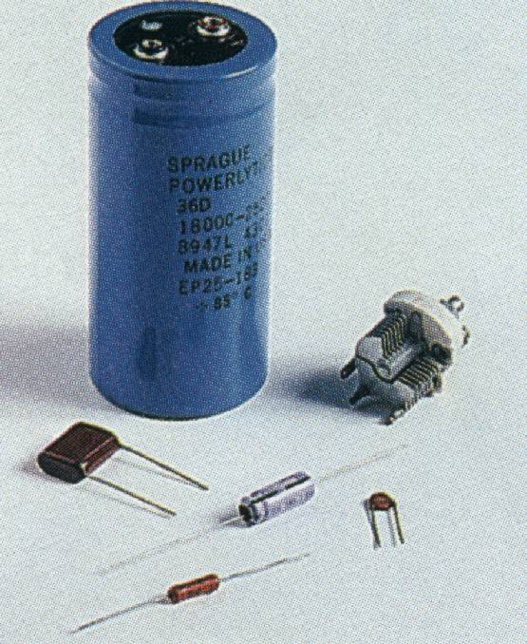
Capacitance (C)
Depends on geometry and nature of the dielectric medium inside the capacitor

Slide 7
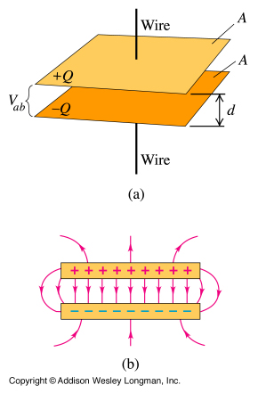
Parallel Plate Capacitor
ε, permittivity
ε₀, permittivity of free space
k, dielectric constant

Slide 8
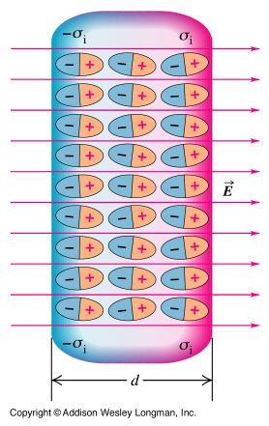
Dielectric
an insulator that can be polarized by an electric field.

Slide 9
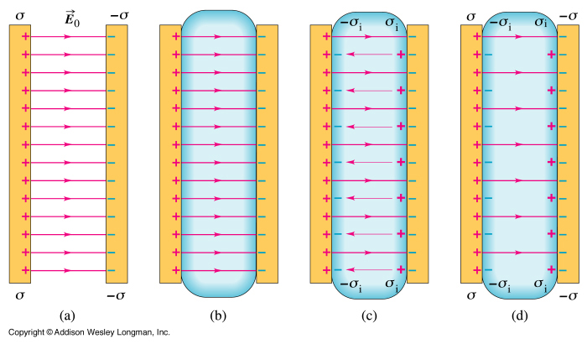
Dielectric
lowers the electric field → lowers the voltage (same charge) → increase capacitance

Slide 10
Electricity
Moving charges
+
+
+
-
-
-

Slide 11
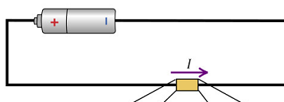
Electricity
Current, I
Voltage, V
Resistance, R

Slide 12
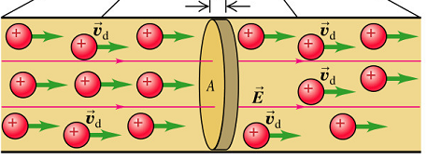
Current, I
Moving charge (rate of flow of charge)
Unit: Ampere

Slide 13
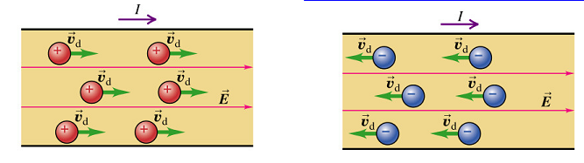
Mobile Charges
Metals : electrons (negative charges)
Semiconductors: electrons (negative charge) or holes (positive charges)

Slide 14
For simplicity
positive charges (moving right) = negative charges (moving left)

Slide 15
Current, I
Direction: same as the direction of moving positive charge or opposite the direction of moving negative charge

Slide 16
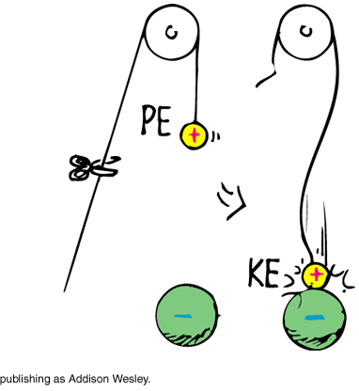

Voltage, V (Potential Difference)
Can cause charges to move
+ 5V
Potential Difference = 3V
+ 2V

Slide 17
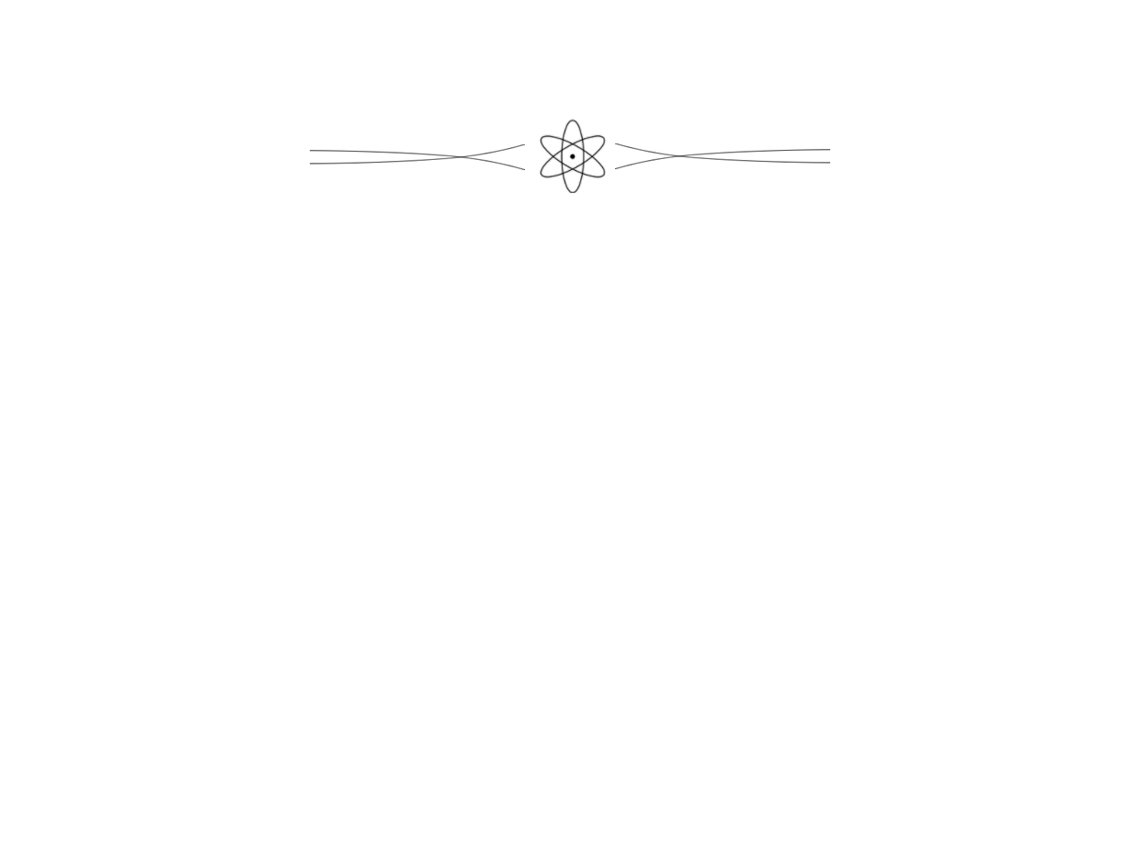
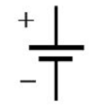
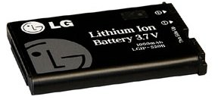
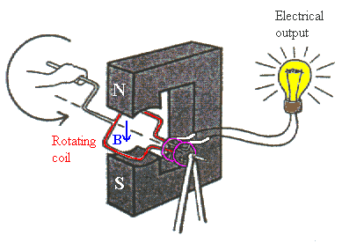
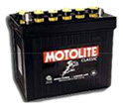
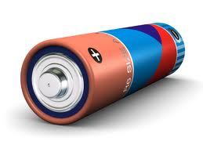
Voltage sources
Batteries
Electric generators
texaswireless1.com
androidspin.com
philippinetires.com

Slide 18

Voltage and Current
Voltage can cause current (moving charges)
Higher Potential
Lower Potential
I

Slide 19
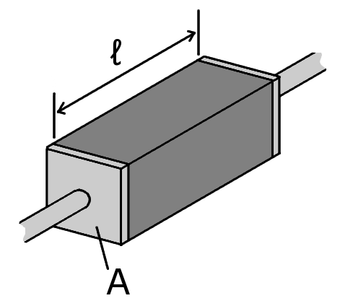
Resistance, R
capacity of materials to impede the flow of current
Unit: ohm (Ω)
ρ = Resistivity

Slide 20
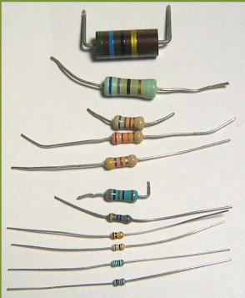
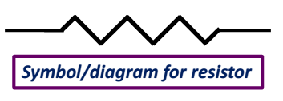
Resistor
device intentionally made to resist current

Slide 21
Types of Materials
Insulator – high resistivity (e.g., plastics)
Conductor – low resistivity (e.g., metals)
Semiconductor – resistivity between insulator and conductor (e.g., Si)
Superconductor – zero resistivity

Slide 22
Ohm’s Law
For ohmic materials: current (I) is directly proportional with the voltage (V). The ratio V/I is constant, which is equivalent to the resistance (R) .

Slide 23
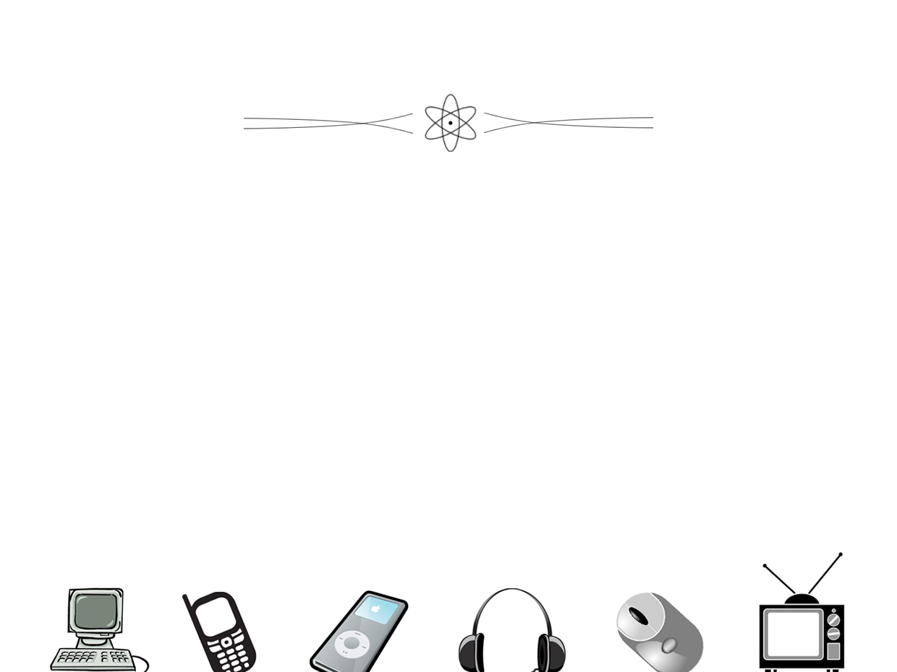
Ohm’s Law
Voltage increases → Current increases (faster movement of charges)
V
I

Slide 24
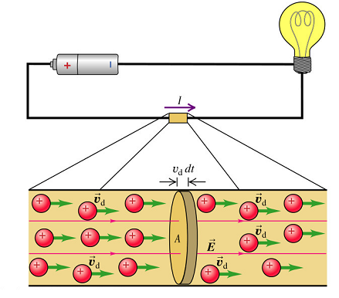
Circuit
Source connected to a sink
V
I

Slide 25
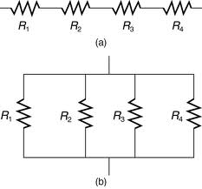
Types of Connection
Series
Parallel

Slide 26
Current
junction : current “in” = current “out” (conservation of charges)
I₂
I₁
Junction
I₃

Slide 27
Current (Series)
I₁
I₂
I₃
I₄

Slide 28
Current (Parallel)
I_{T}
I₁
I₂
I₃
I₄

Slide 29
Voltage (Series)
V_{T}
V₁
V₂
V₃
V₄

Slide 30
Current (Parallel)
V_{T}
V₁
V₂
V₃
V₄

Slide 31
Resistors in series

Slide 32
Resistors in series

Slide 33
Resistors in Parallel

Slide 34
Resistors in Parallel

Slide 35
Combinations

Slide 36
Combinations

Slide 37
Exercise: Compute the total resistance (R_{T})

Slide 38
R₁₂

Slide 39
R₁₂₃

Slide 40
R_{T}

Slide 41
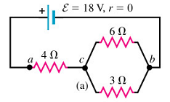
Circuit
Compute:
Total resistance (R_{T})
Total current (I_{T})
R₁ Current (I₁)
R₁ Voltage (V₁)
R₂ Voltage (V₂)
R₃ Voltage (V₃)
R₂ Current (I₂)
R₃ Current (I₃)

Slide 42
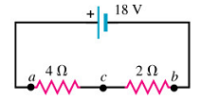
1) Total resistance (R_{T})

Slide 43
2) Total Current (I_{T})
Ohm’s Law

Slide 44
3) R₁ Current (I₁)
Conservation of charges:

Slide 45
4) R₁ Voltage (V₁)
Ohm’s Law

Slide 46
5,6) R₂ Voltage (V₂) and R₃ Voltage (V₃)

Slide 47
7) R₂ Current (I₂)
Ohm’s Law

Slide 48
8) R₃ Current (I₃)
Ohm’s Law

Slide 49
Electric Power (P)
rate at which energy is converted from the electrical energy to some other form (e.g., heat, mechanical energy)

Slide 50
Example
A 12 Ω resistor carries a current of 3 A. Find the power dissipated in the resistor.

Slide 51
Direct Current vs. Alternating Current
Direct current (DC)
current is constant with respect to time.
The voltage which drives the current is also constant with respect to time
Alternating current (AC)
current varies periodically with time
The voltage which drives the current varies periodically with time

Slide 52
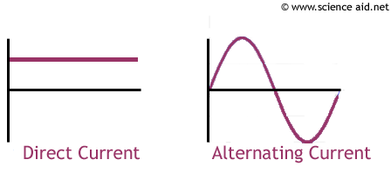
DC and AC
I
I
time
time

Slide 53
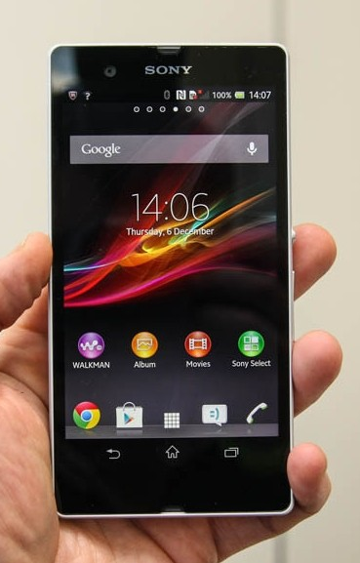
TOUCH!
Ways of making a touch screen device
resistive touch screen
capacitive touch screen

Slide 54
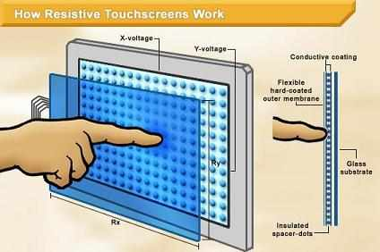
Resistive Touch Screen
infoceanhub.com

Slide 55
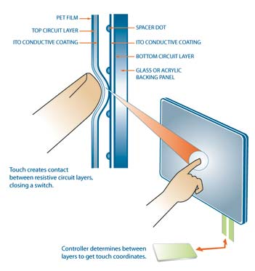
epicagear.com

Slide 56
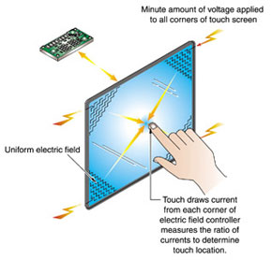
Capacitive Touch Screen
http://www.completetab.com

